Slide 1

GECO Club
July 27, 2019
GECO Club
July 27, 2019
Game Design
& Pseudocode
Club Mentors
Mr Dion Collier Ms Pia Roden
Mr Joshua Wellman Ms Makena Collier
Ms Stef Rand Mrs Sharon Martin

Slide 2
GECO Club
July 27, 2019
GECO Club
July 27, 2019
Game Design
& Pseudocode

Slide 3
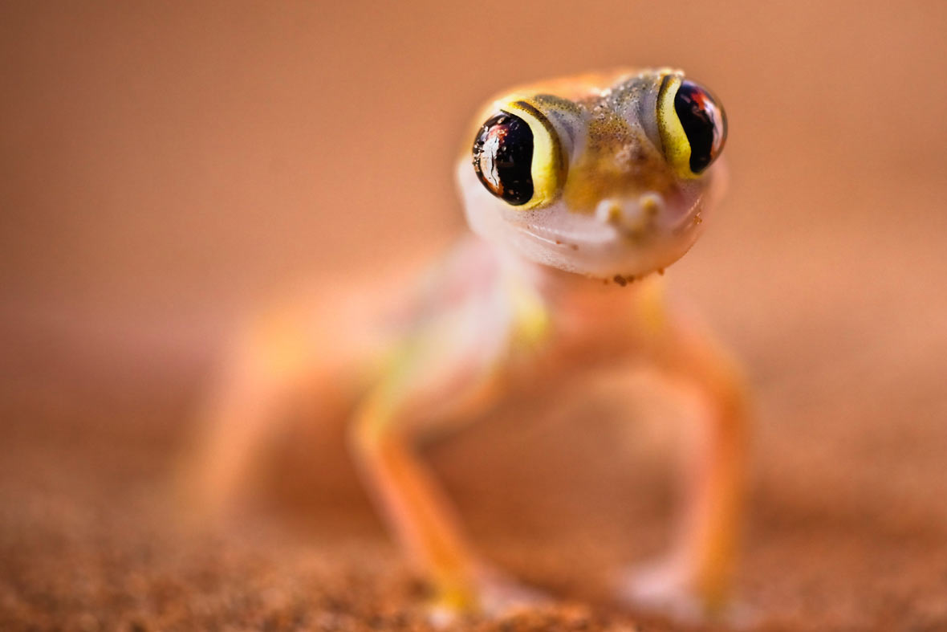
Welcome
Welcome
Girls Engineering & Coding Organization
(GECO Club)
Girls Engineering & Coding Organization
(GECO Club)

Slide 4
Why game design?
You said you wanted to try it!
Games are fun!
Great way to express creativity and code at the same time!
Can learn some really neat code!

Slide 5
Agenda:
Game demo
Game design
Activity
Pseudocode
Activity
*Time Permitting*
Work on some game code!

Slide 6
Demo
You’re walking in the woods…

Slide 7
Simple, right?
Behind the scenes….let’s look at the code!

Slide 8
Game Design: The Basics
Good game design is like writing a good story
What are your goals?
What experience do you want your users to have?
Setting? Genre? What kind of game?
What challenges or puzzles do you want to include?
Rewards?
Making sure your game is good on paper saves time and money in the real world!

Slide 9
First Activity: Game and puzzle design!
Can work solo, with a partner, or in a group
If you work solo, you have to have “co-creator” to talk to about your ideas!
Design a narrative mini-game with a single puzzle
Game setting
Goal of puzzle
What kind of puzzle & what is the solution?
What happens???
NOT in code! Just writing & being creative for now

Slide 10
What is pseudocode?
Pseudocode is a step-by-step written outline of your code
You can turn your pseudocode into your Python code
If your pseudocode logic works, your coding logic will be better
Psuedocode is written in plain English.
IT IS NOT CODE
So it is completely ok if you don’t know
what code you need to know yet!!!

Slide 11
Stef’s Pseudocode…

Slide 12
Second Activity: Pseudocode your mini-game
Now we are going to write out pseudocode for your puzzle!
Write out actions that you want to have happen
Write out the things you need present in the puzzle
Is there logic? (If – then statements, cause and effect)
It is ok if you don’t know exactly how to write the code!
Mentors are here to help!

Slide 13
Time permitting: Let’s write some code!
Our pseudocode gives us a framework!
You can use my code to start, if you want to!
Or can come up with own
Or can look online for Python game code examples
We are here to help you!
Use your pseudocode as a framework/checklist for your code.

